Slide 1



Analysis of Modern Relationship
View in Power BI
Last data refresh:
6/13/2021 5:26:53 PM UTC
Downloaded at:
7/8/2021 10:12:16 AM UTC

Slide 2
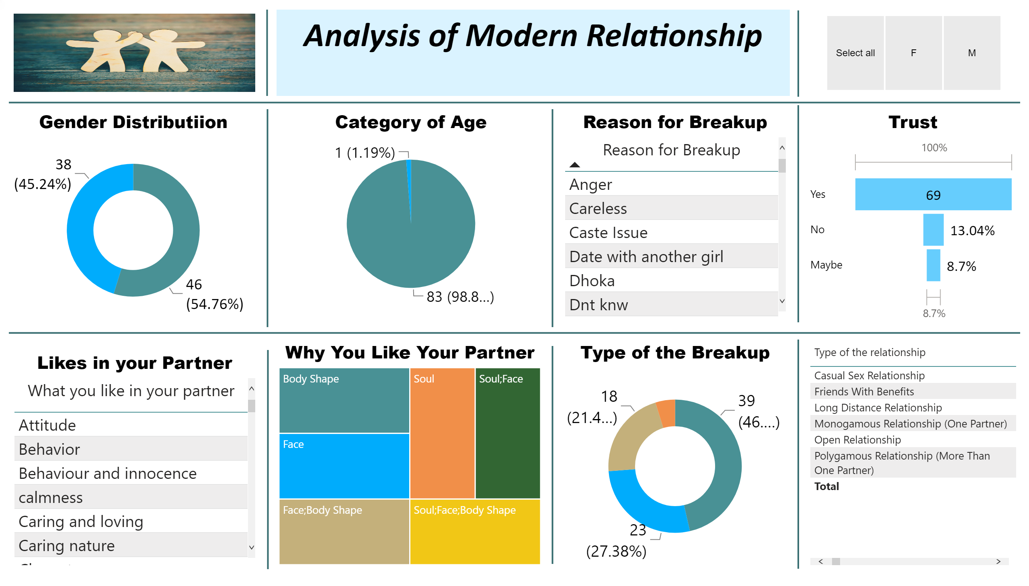
AOMR
Notes:
Gender Distributiion
No alt text provided.
shape
No alt text provided.
image
No alt text provided.
shape
No alt text provided.
shape
No alt text provided.
shape
No alt text provided.
Category of Age
No alt text provided.
Likes in your Partner
No alt text provided.
Why You Like Your Partner
No alt text provided.
shape
No alt text provided.
shape
No alt text provided.
shape
No alt text provided.
shape
No alt text provided.
shape
No alt text provided.
textbox
No alt text provided.
shape
No alt text provided.
Type of the Breakup
No alt text provided.
Type of the relationship
No alt text provided.
Trust
No alt text provided.
Reason for Breakup
No alt text provided.
slicer
No alt text provided.

